Slide 1

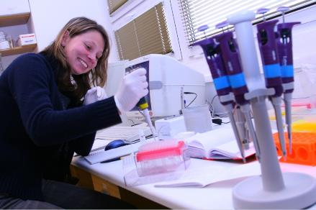
Young researchers’ award
Academy of Sciences
of the Czech Republic
Vendula Rusňáková (1983)
Master´s studies: 2003-2008
Laboratory of Virology
Dpt. of Biochemistry and Biochemistry
Institute of Chemical Technology, Prague
Dean’s prize
PhD studies: 2008 - present
Faculty of Science, Charles University, Prague
Department of Gene Expression
Institute of Biotechnology
Academy of Sciences of the Czech Republic

Slide 2
Vendula Rusňáková
Academy of Sciences
of the Czech Republic
International Fellowships:
August-September 2011: EMBO Fellowship, Department of Pathology, Lundberg laboratory for Cancer Research, Sahlgrenska University Hospital, Goteborg, Sweden
February and May 2010: ESF Fellowship Department of Pathology, Lundberg laboratory for Cancer Research, Sahlgrenska University Hospital, Goteborg, Sweden
Courses:
Pre IMPACT training course: My journey with new technologies: everything I ever wanted to know, but never dared to ask (May 6-7, 2009), Brussels, Belgium
FEBS advanced course: Structural Variations in Genome, Gene Expression, Single Cell Analysis: Arrays, Beads,High-throughput Sequencing, (September 12-20,2008) Prague, Czech republic
TATAA Biocenter training in real-time quantitative PCR, (20th November- 25th November 2008) Prague, Czech Republic

Slide 3
Vendula Rusňáková
Academy of Sciences
of the Czech Republic
Grants:
Principal investigator
Grant Agency of Charles University (2009): Quantification of HER2 gene amplification in cancer tissue by qPCR and digital PCR
Member of the team
Seventh framework program (2008 - 2012): Standardization of generic pre-analytical tools and procedures for in vitro diagnostics
Contact AMVIS (2010-2012): Cellular Expression Signatures in Idiopathic Pulmonary Fibrosis
The Grant Agency of the Czech Republic (2010-2012): Cell volume regulation in glial cells during brain ischemia/reperfusion
The Grant Agency of the Czech Republic (2009 - 2011): Formation of spatiotemporal molecular gradients in early development of Xenopus leavis
The Grant Agency of the Academy of Sciences of the CR (2009 -2011): MicroRNA expression during early development of Xenopus leavis and mRNA degradation
The Grant Agency of the Academy of Sciences of the CR (2008 - 2010): Mechanisms of embryonic stem cells early differentiation
IGA (2008 - 2010): Gene expression profiling in cancer circulating cells (CTCs) in breast carcinoma patients - a tool for early metastasis detection and therapy individualization

Slide 4
Vendula Rusňáková
Academy of Sciences
of the Czech Republic
List of publications:
1. PCR Technology: Current Innovations, Third Edition. Editors: Nolan T, Bustin SA. Dye based high throughput qPCR in microfluidic platform BioMarkTM. Svec D, Rusnakova V, Korenkova V, Kubista M. CRC Press , April 15, 2013, 448 Pages
2. The Increased Activity of TRPV4 Channel in the Astrocytes of the Adult Rat Hippocampus after Cerebral Hypoxia/Ischemia. Butenko O, Dzamba D, Benesova J, Honsa P, Benfenati V, Rusnakova V, Ferroni S, Anderova M. PLoS One. 2012;7(6):e39959. IF=4.092
3. Paternal benzo[a]pyrene exposure affects gene expression in the early developing mouse embryo. Brevik A, Lindeman B, Rusnakova V, Olsen AK, Brunborg G, Duale N. Toxicol Sci. 2012 May 28. IF= 4.652
4. Quantitative Real-time PCR in Applied Microbiology. Editors: Martin Filion M. Genex: Data Analysis Software. Kubista M, Rusnakova V, Svec D, Sjogreen B, Tichopad A. Caister Academic Press, Chapter 4. 2012 May
5. Distinct expression/function of potassium and chloride channels contributes to the diverse volume regulation in cortical astrocytes of GFAP/EGFP mice. Benesova J, Rusnakova V, Honsa P, Pivonkova H, Dzamba D, Kubista M, Anderova M. PLoS One. 2012;7(1). IF=4.092
6. Detection of immune cell response to M. tuberculosis-specific antigens by quantitative polymerase chain reaction. Bibova I, Linhartova I, Stanek O, Rusnakova V, Kubista M, Suchanek M, Vasakova M, Sebo P. Diagn Microbiol Infect Dis. 2012 Jan;72(1):68-78. IF= 2.528
7. Preconceptional paternal glycidamide exposure affects embryonic gene expression: single embryo gene expression study following in vitro fertilization. Brevik A, Rusnakova V, Duale N, Slagsvold HH, Olsen AK, Storeng R, Kubista M, Brunborg G, Lindeman B. Reprod Toxicol. 2011 Dec;32(4):463-71. IF= 3.226

Slide 5
Vendula Rusňáková
Academy of Sciences
of the Czech Republic
List of publications:
8. Gene expression profiling--Clusters of possibilities. Bergkvist A, Rusnakova V, Sindelka R, Garda JM, Sjogreen B, Lindh D, Forootan A, Kubista M. Methods. 2010 Apr;50(4):323-35. IF=4.011
9. Analysis of in vitro and in vivo characteristics of human embryonic stem cell-derived neural precursors. Kozubenko N, Tunovcova K, Kapcalova M, Butenko 0, Anderova M, Rusnakova V, Kubista M, Hampl A, Jendelova P, Sykova E. Cell Transplant. 2009 Dec 18. IF= 6.204

Slide 6
Single cells gene expression profiling and analysis
Vendula Rusňáková
Laboratory of Gene Expression
Institute of Biotechnology AS CR

Slide 7
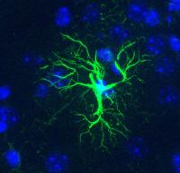
Our studied model - Astrocytes
  90 % of neural cells are glial cells
  80 % of glial cells are astrocytes
  Astrocytes have a star shape
  Typical marker – Glial fibrillary acidic protein (GFAP)
  Main functions:
  - Structural (surrounding of neurons)
    - Extracellular transport of K⁺
    - Capture of glutamate
    - Reparation of CNS
100 μm
Protoplasmatic astrocytes in grey matter

Slide 8
Design of Experiment
Transgenic mouse
GFAP promotor
GFP (green flouorescent protein)
(all cells expressing GFAP are green)
Injury study
Collection of cells by FACS (Fluorescence-activated cell sorting)
50 days old mice (P50) and mice 3 (D3), 7 (D7), 14 (D14) days after focal cerebral ischemia
96 cells from each animal
Analysis of 46 genes (PCA and SOM): glial cell markers, developmental markers, aquaporins, subunits of glutamate, ionotropic and metabotropic receptors, K⁺ channels and hyperpolarization-activated cyclic nucleotide-gated channels

Slide 9
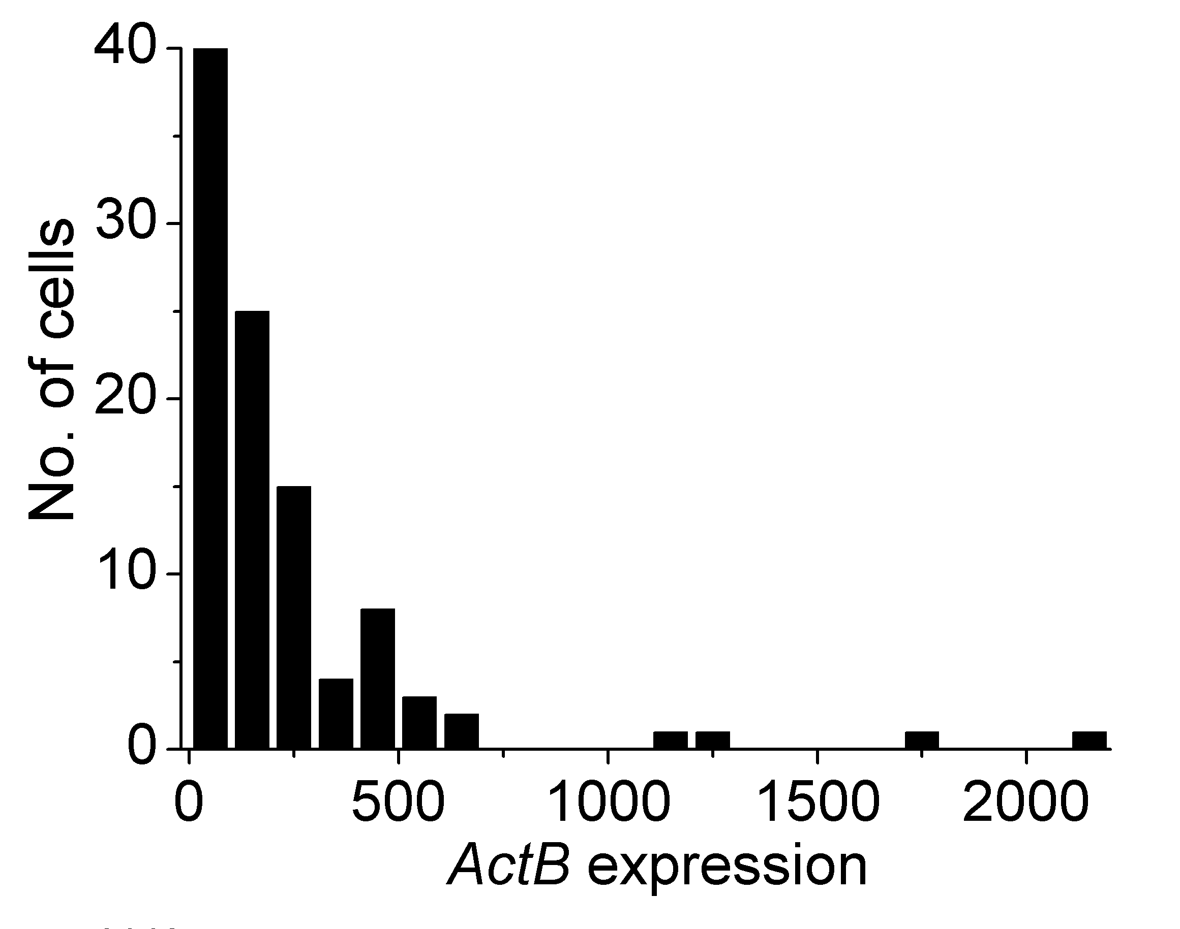
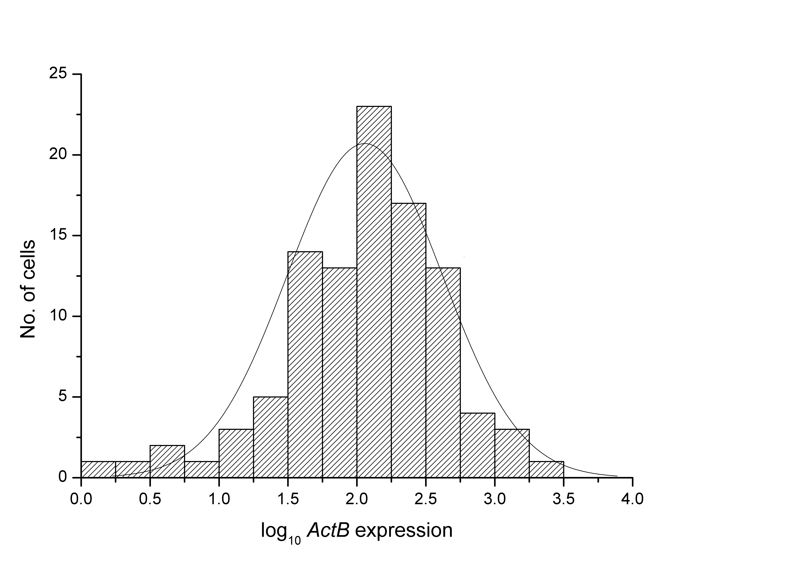
How to analyze qPCR data?
Descriptive statistics – mean, count, median, distribution, correlation coeficient
Principal component
Analysis (PCA)
Kohonen self-organizating
Map (SOM)
Dendrograms
Ståhlberg et al. Methods 2012, Berkvist at al., Methods, 2011, Benesova et al, PlosOne, 2012

Slide 10
Conclusions
We have developed and optimized method for single cells qPCR and analysis
It has been proved that PCA and SOM are useful tools to find new groups of cells
We have identified new subgroups of astrocytes in development of reactive astrogliosis
We have identified new genes which are important in reactive astrocytes

Slide 11
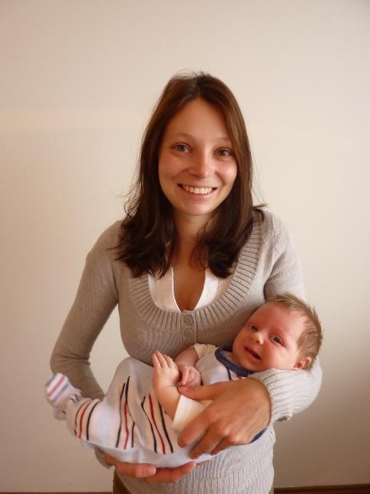

Slide 13
Why to study single cells?
Total # of = 7
Total # of = 7
To identify and characterize rare cells
To explore population heterogenity
Total # of = 6
Total # of = 6
Total # of = 4
Total # of = 4
To refine biomarker analysis and true correlations of transcripts

Slide 14
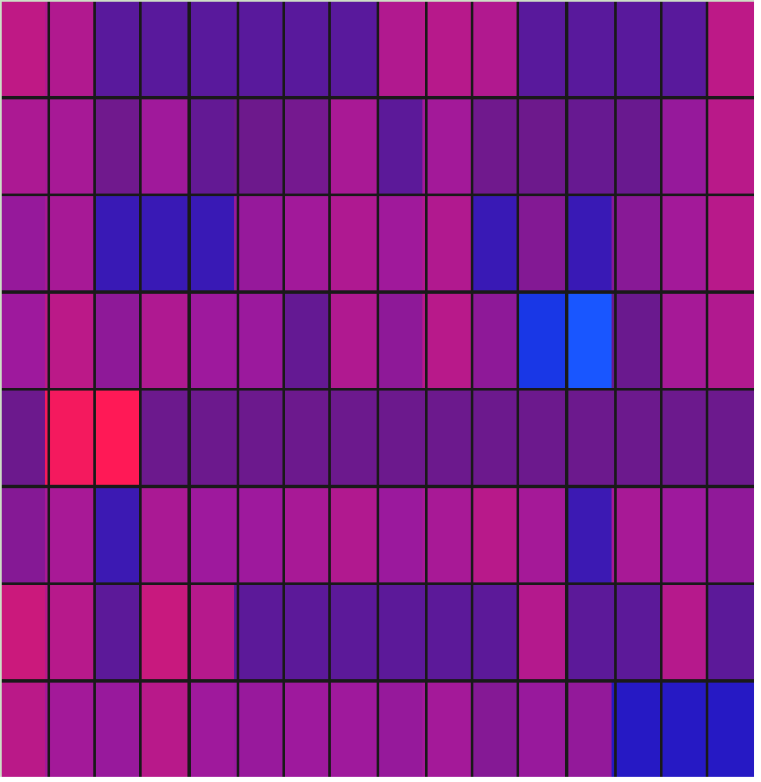
Single cells gene expression workflow
Cell collection Lysis Reverse Pre
transcription amplification
qPCR Data analysis
Ståhlberg et al. Expert Rev Mol Diagn. 2011

Slide 15
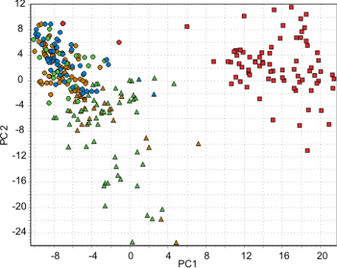
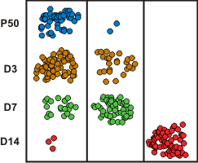
Results
PCA
SOM
All cells were divided into 3 groups by both methods.
Rusnakova at al., submited Cerebral Cortex, 2012

Slide 16
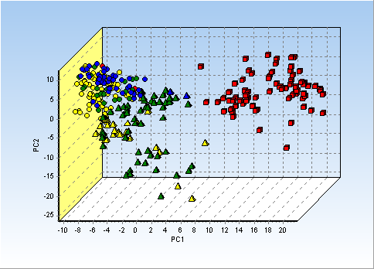
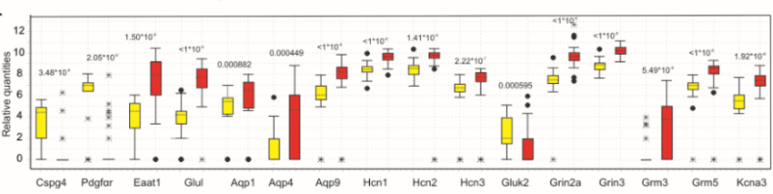
Results
3rd principal component in PCA divides reactive astrocytes into two subgroups.

Slide 17
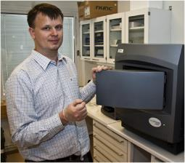
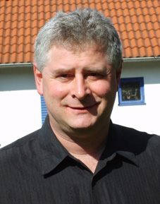
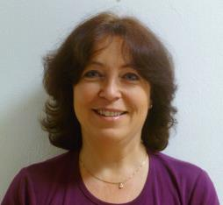
Acknowledgement
Anders Ståhlberg
Miroslava Anděrová
Mikael Kubista

